Slide 1
Project ALAMO
Federated Learning – Preliminary results

Slide 2
Schedule
Implementation
Pipeline
Outcomes

Slide 3
Implementation
8

Slide 4
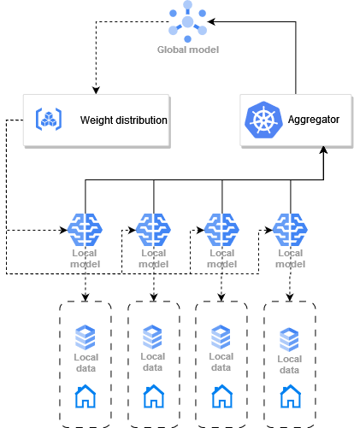


Implementation
Possibilities
Using a framework
called Flower
Doing it from scratch

Slide 5

Implementation using the framework
Flower Framework
Advantages
Drawbacks
F.L. algorithm set up by methods
Documention
Client-server connection implemented
Debugging
A complete solution
Made me take a step backwards!
8

Slide 6
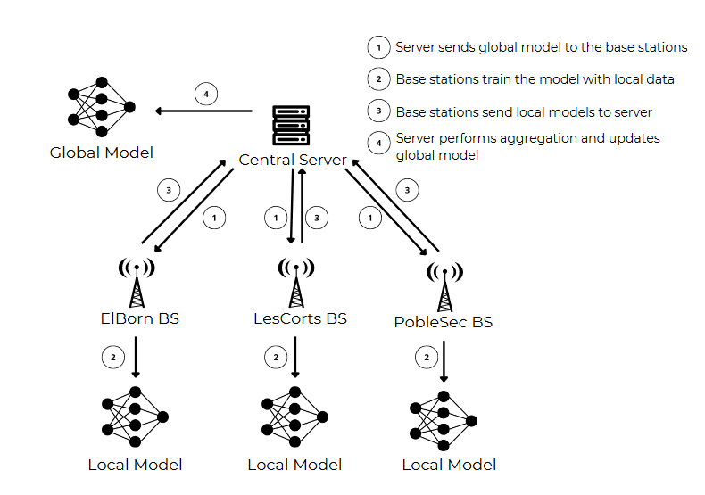
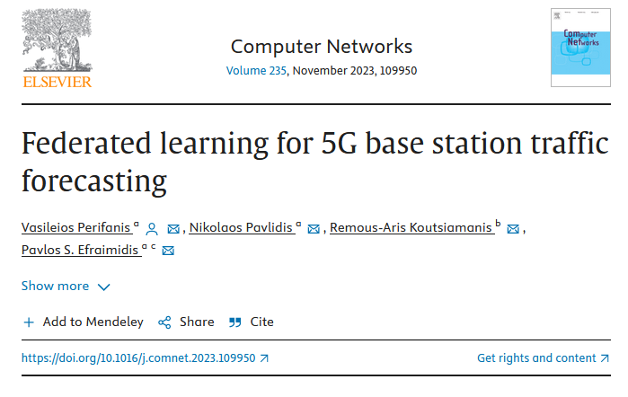

Implementation from scratch
Inserted on the regression domain
Better pipeline
F.L. Implemented from scratch
vperifan/Federated-Time-Series-Forecasting
8

Slide 7
Pipeline
8

Slide 8

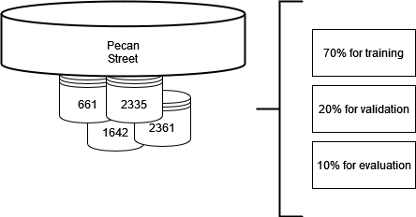
Pipeline
Version of 25 participants
(consumption of households)
Represents an horizontal F.L
*Used in both
implementation
8

Slide 9
Outcomes
8

Slide 10
Outcomes – Training Time
Hyperparameters
5 hours of training
Batch-size: 128
Epochs: 150
F.L.. Rounds: 10
Fraction: 0.25
4 hours of training
8

Slide 11
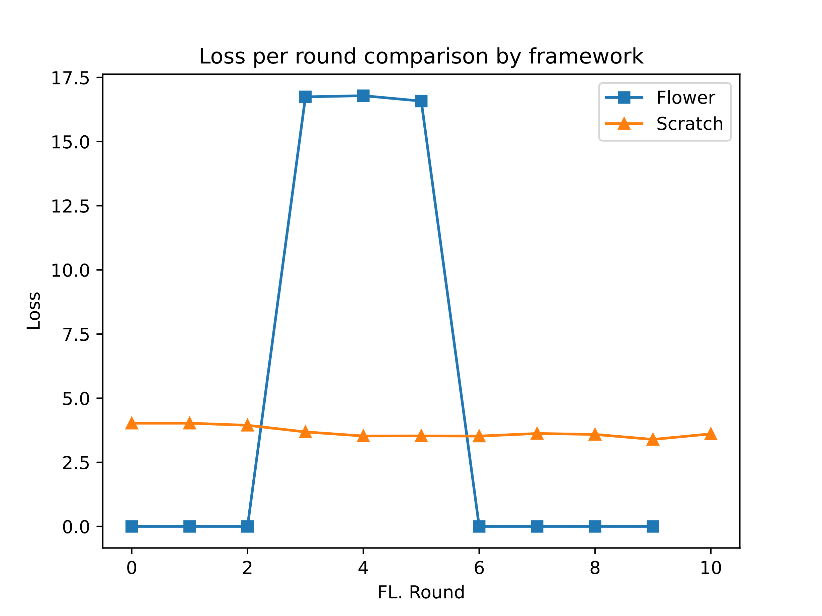
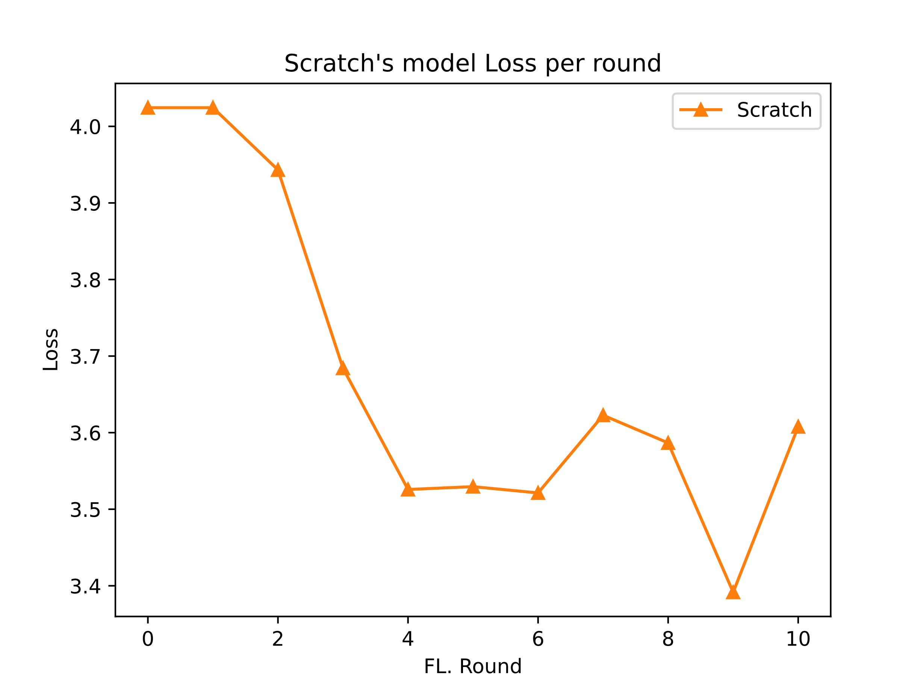
Outcomes – Training losses
8

Slide 12
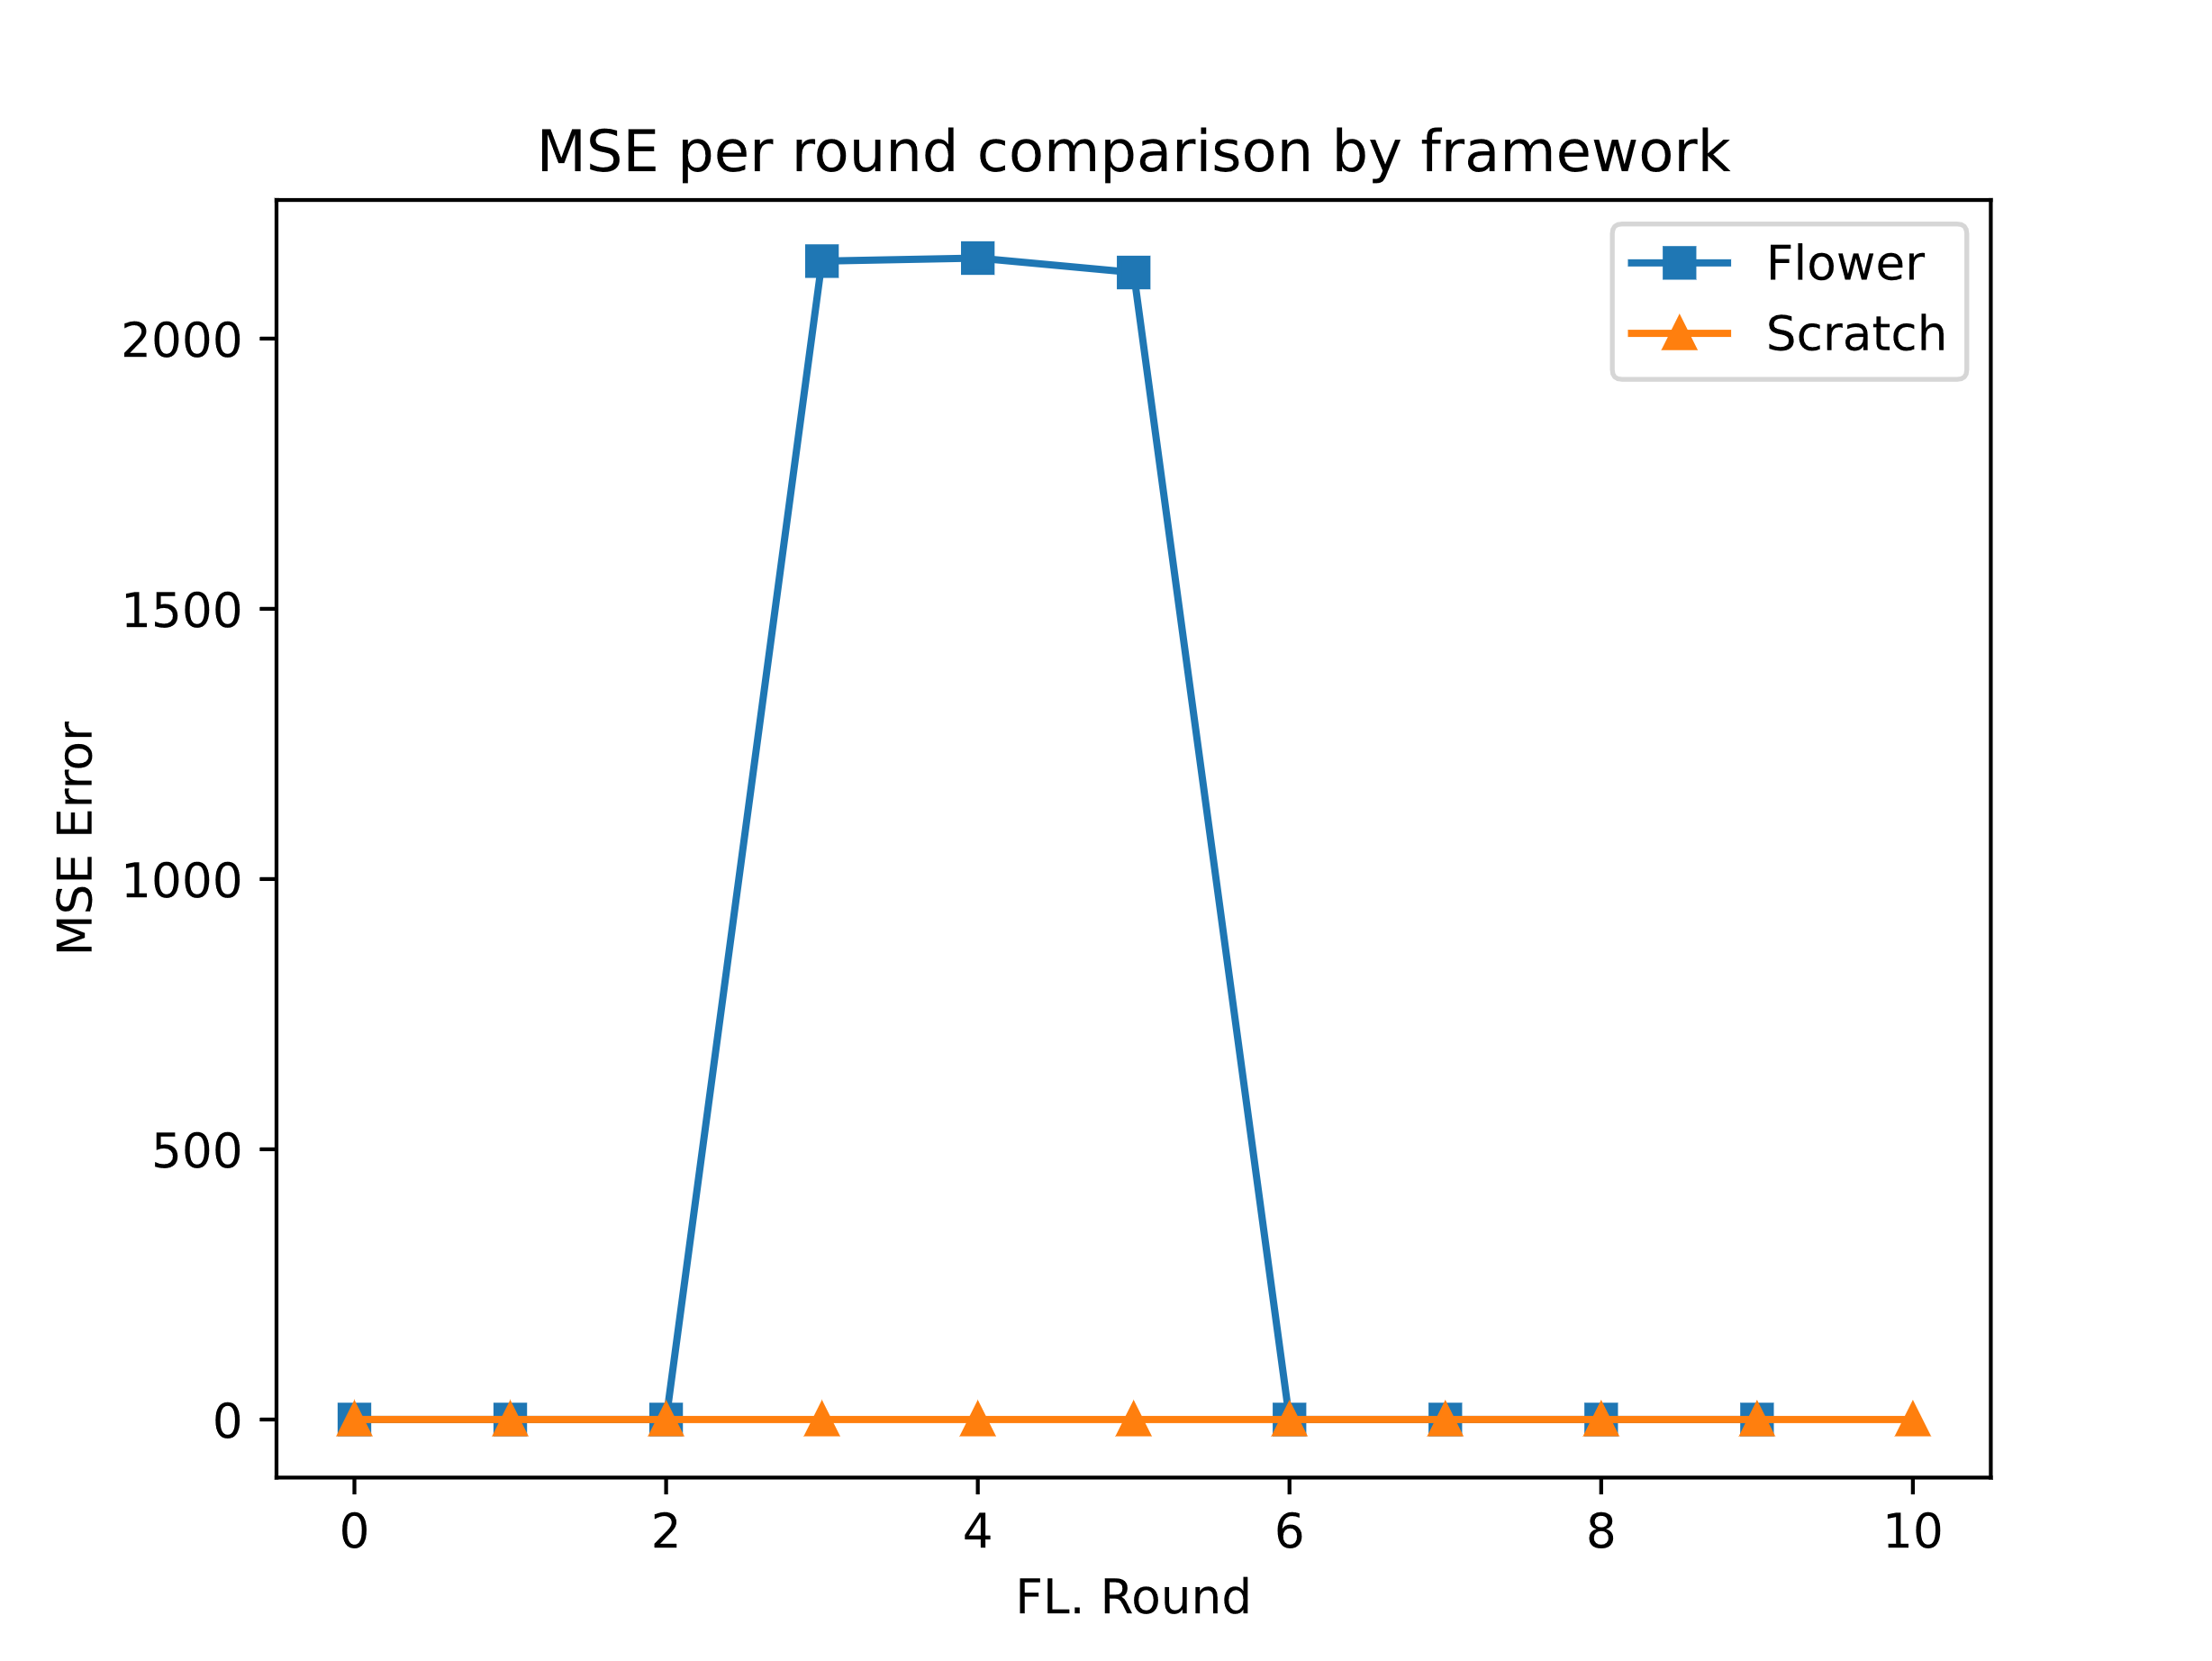
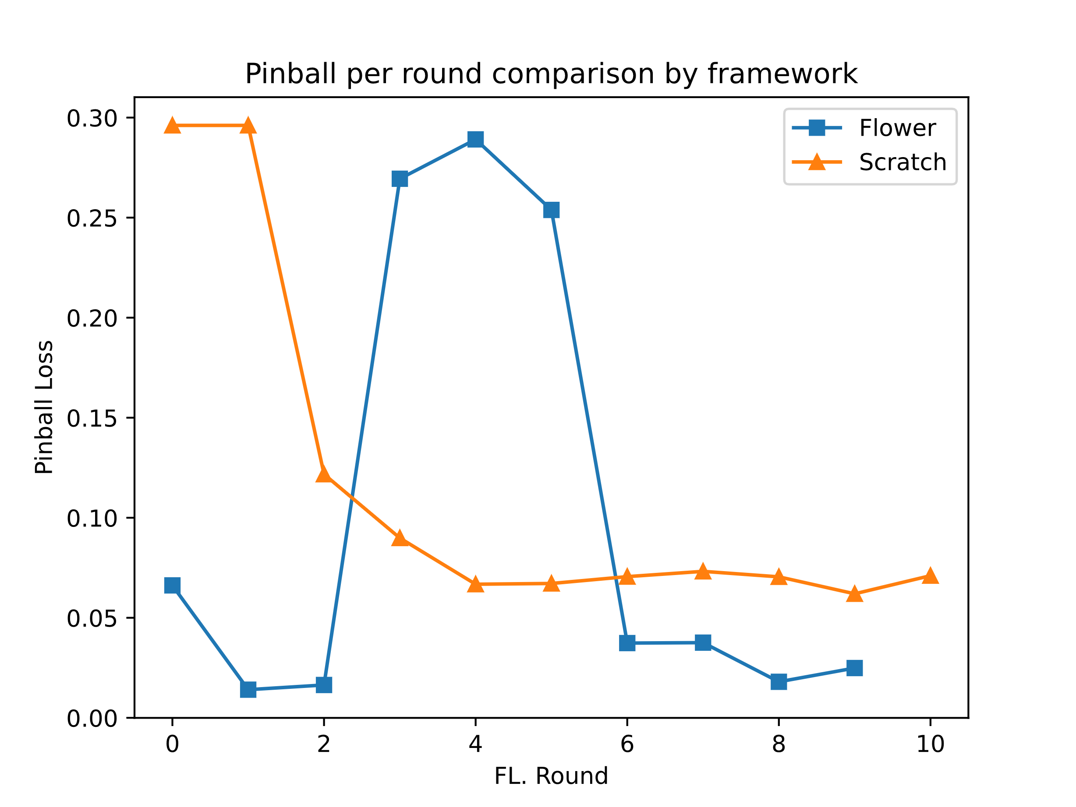
Outcomes - Evaluation
8

Slide 13
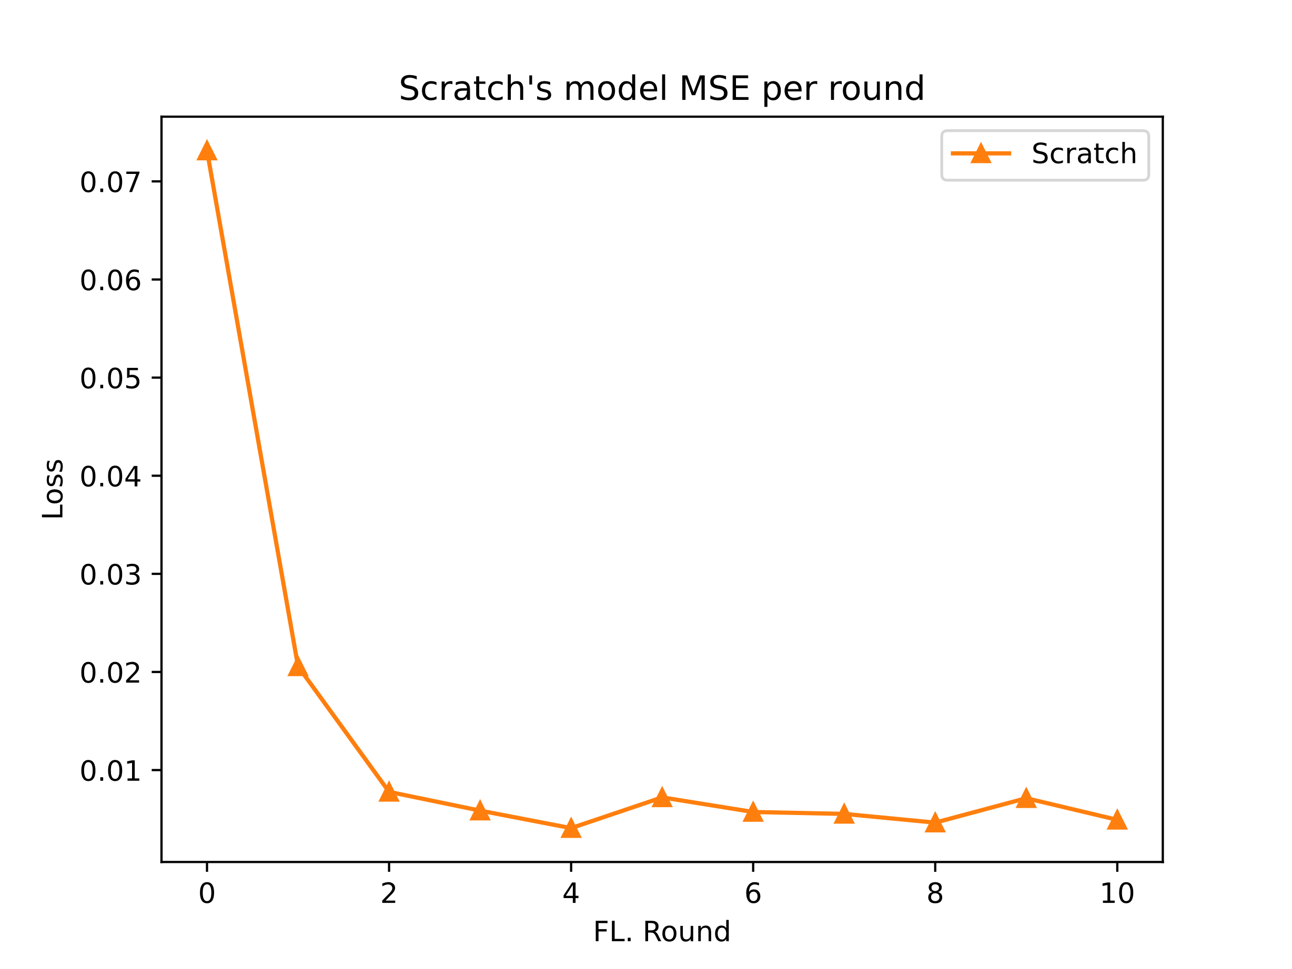
Outcomes - Evaluation
8

Slide 14
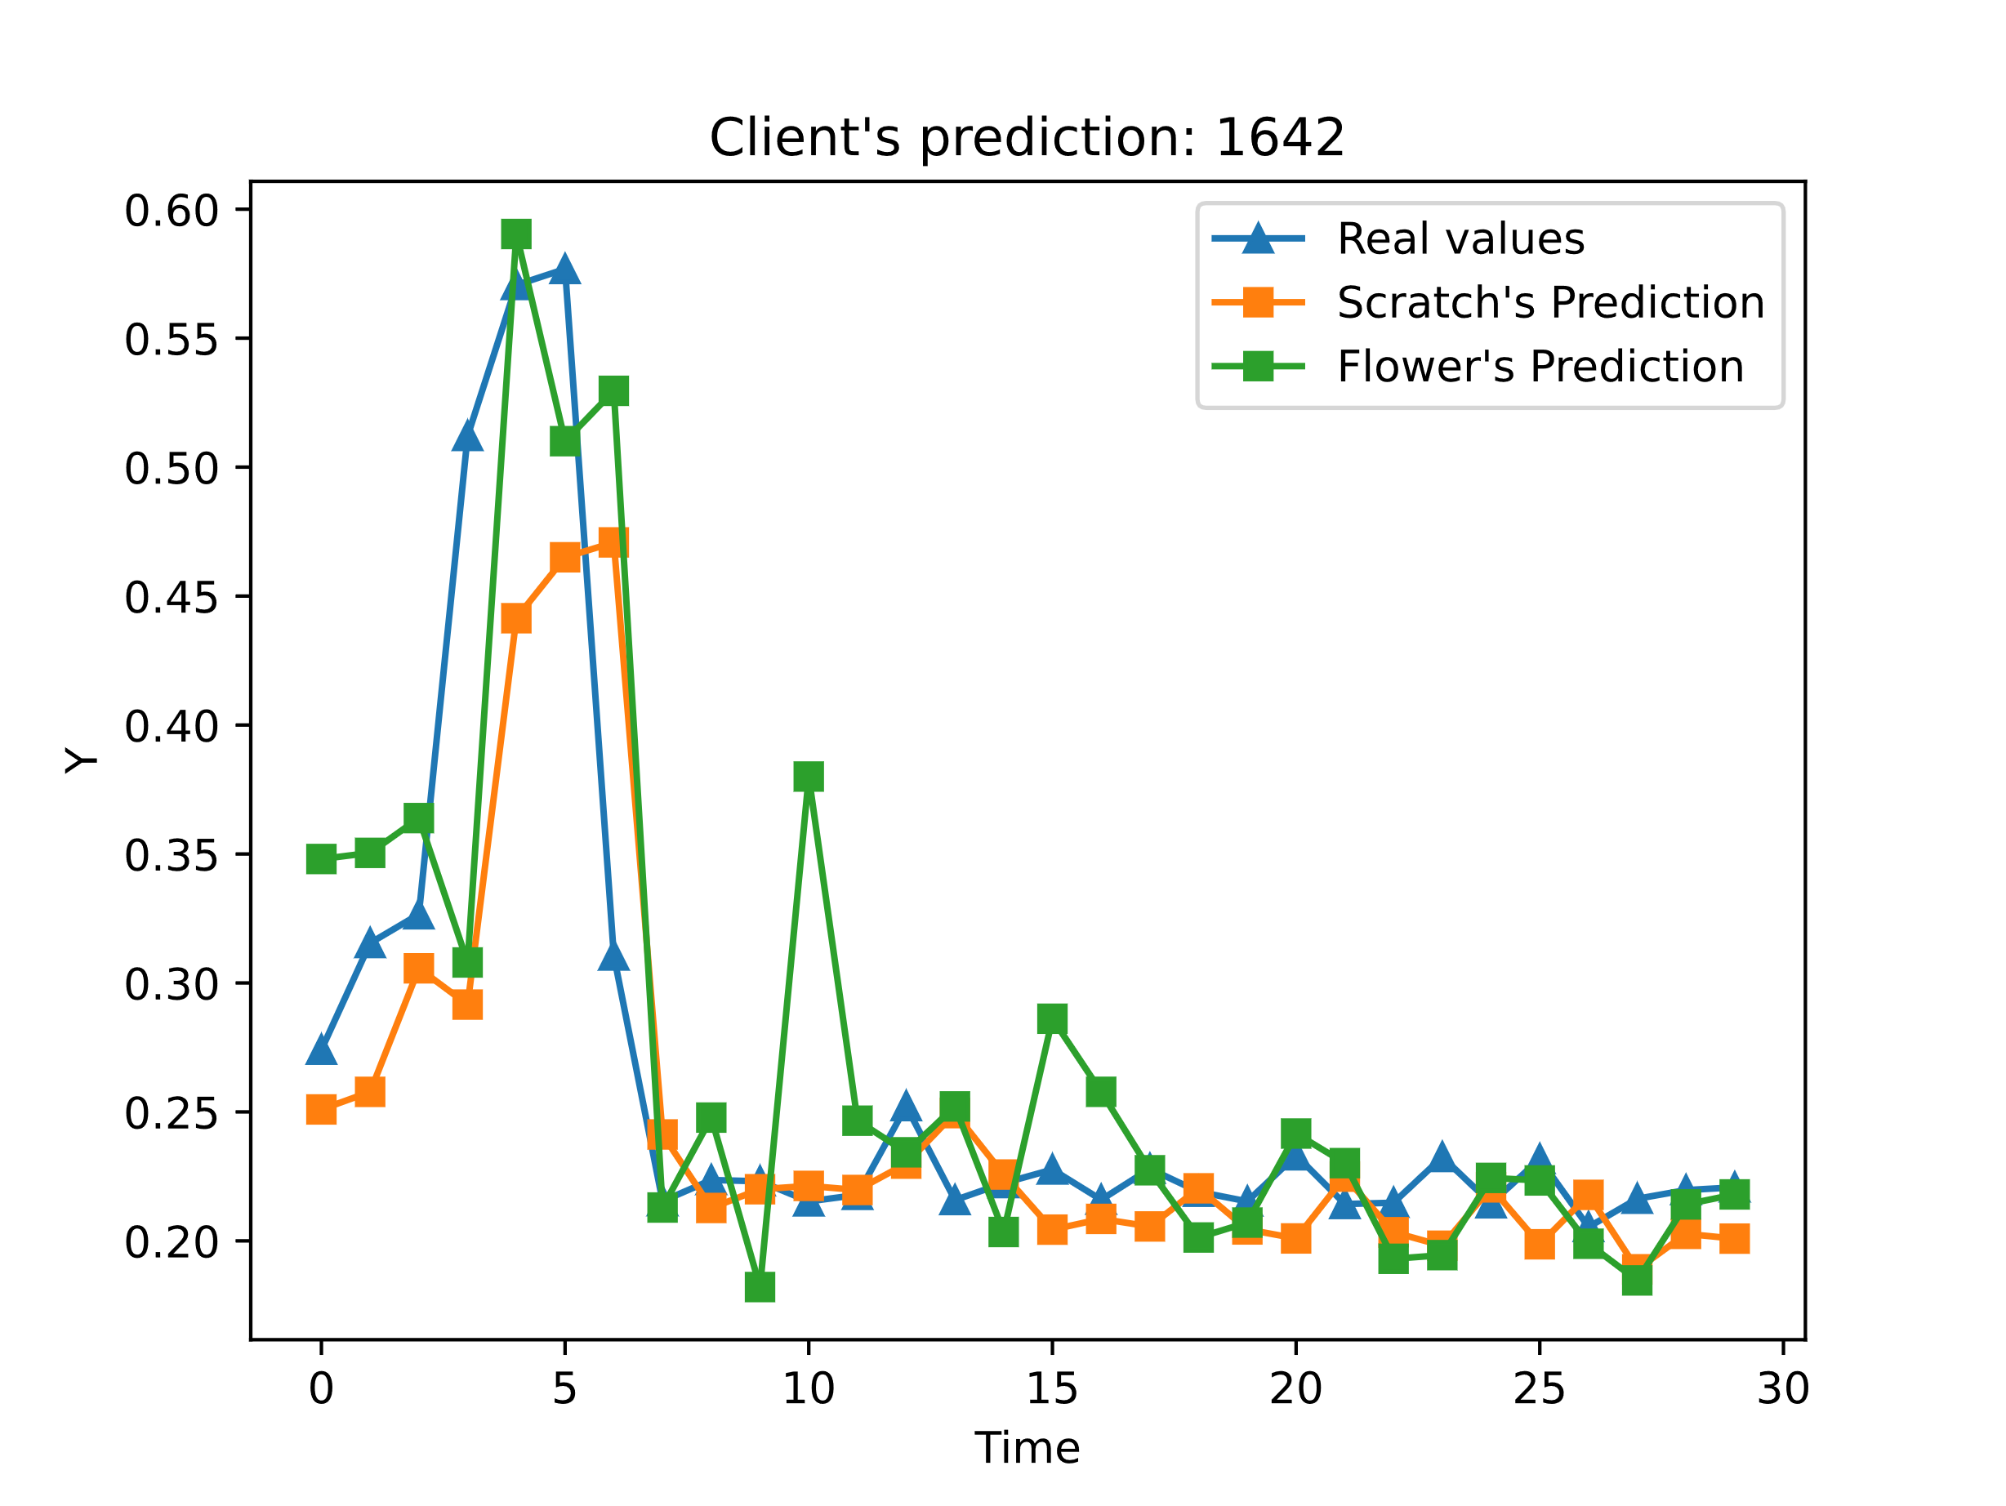
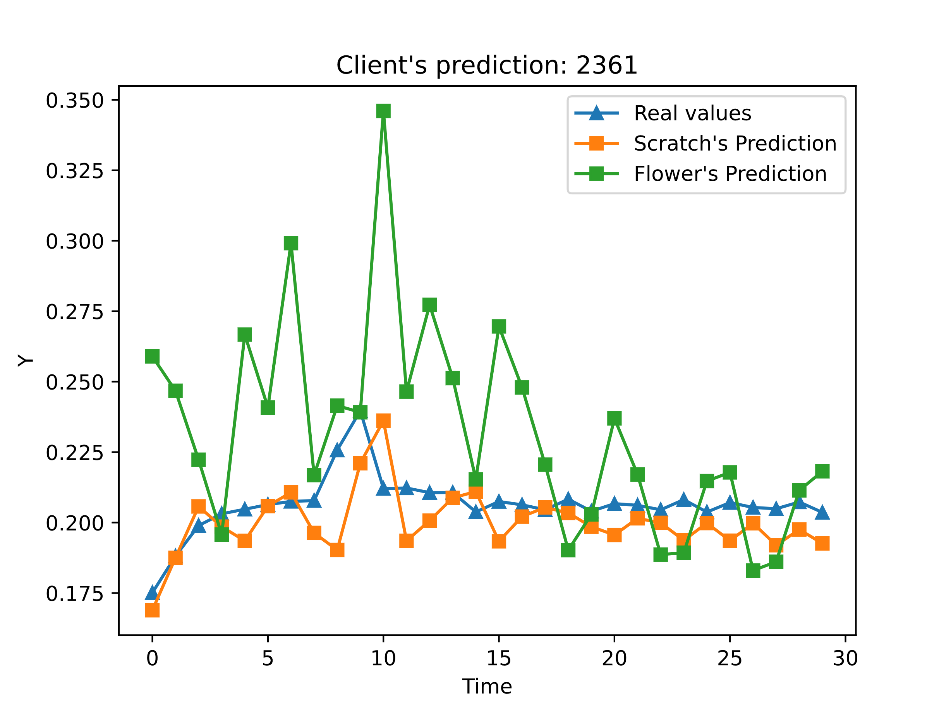
Outcomes - Forecast
8

Slide 15
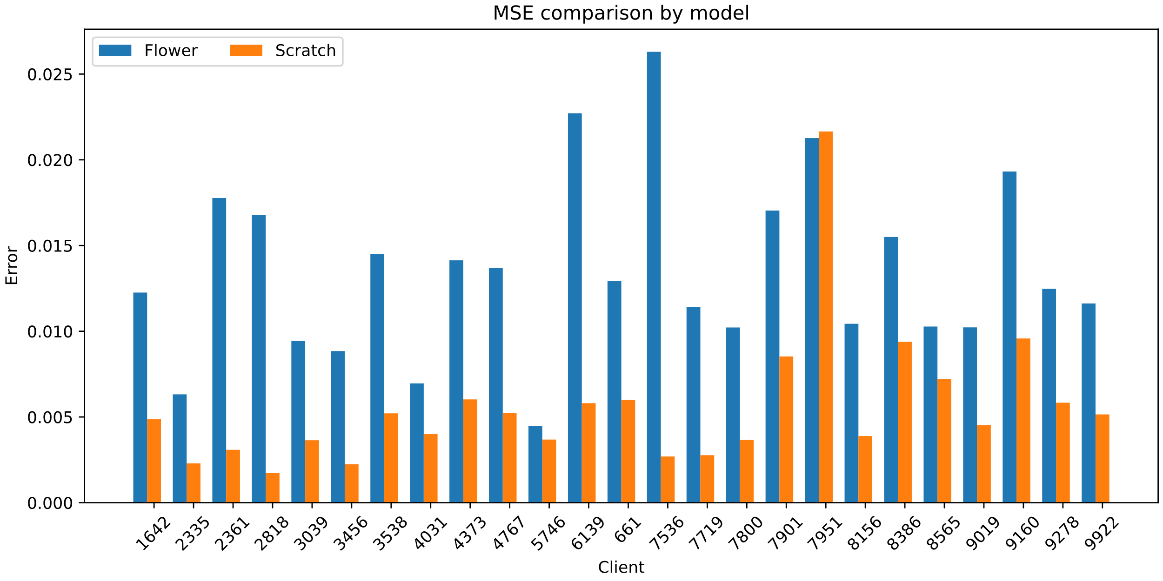
Outcomes – Evaluation per client
8

Slide 16
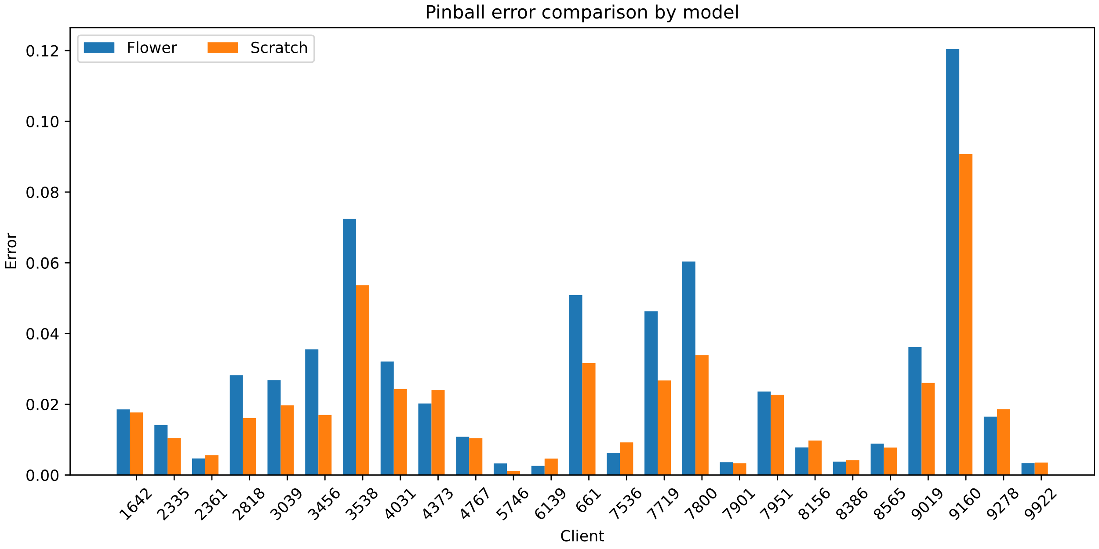
Outcomes – Evaluation per client
8

Slide 17
Thank you!
8

Slide 18
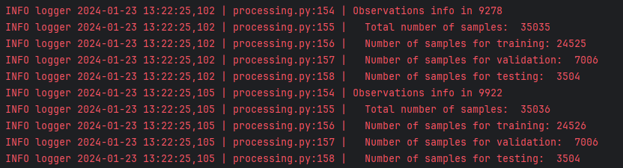
Outcomes
8

Slide 19
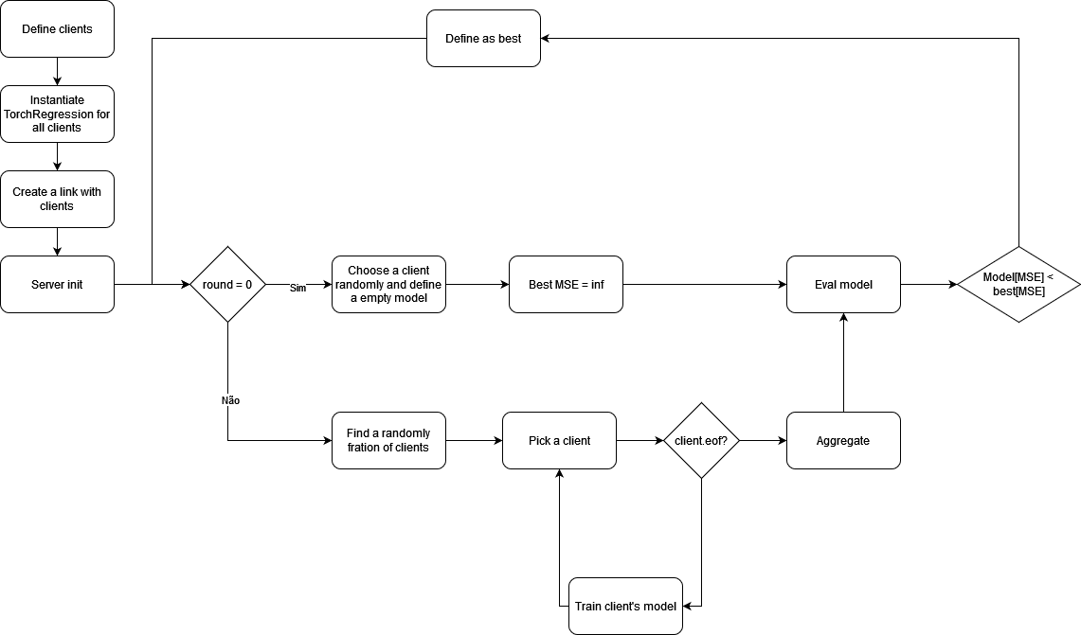
Outcomes
8

Slide 20
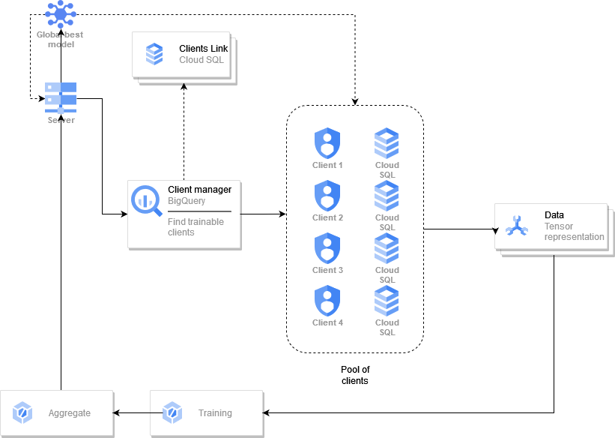
Outcomes
8

